Slide 1



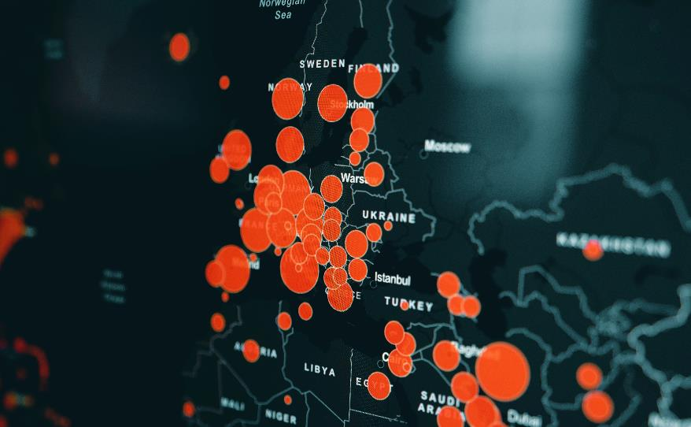
Prediction And Visualization Of The FMCG Stocks Prices
10600575 – Konika Sankhe

Slide 2

01
Introduction
Literature Review
02
03
State of the Art
Table of
Contents
Research Methodology
04
05
Conclusion
Bibliography
06

Slide 3





Introduction
Covid and War have imparted a priceless lesson for life. Countries' economies crumbled during the epidemic. An area of multidisciplinary scientific inquiry is stock price forecasting. In the area of time series prediction, it is a widely utilized application.
Ten years worth of historical stock price information will be made available for the fast-moving consumer goods (FMCG) sector by India's NSE and BSE. The years 2012 to 2022 will be chosen for the historical dataset. This work suggests the Deep Learning (DL)-based Long Short-Term Memory (LSTM) Algorithm and Auto-ARIMA. Additionally, the outcomes show that the Power BI platform can give an analysis of stock price patterns in an original and efficient manner. The research aims to forecast the churns for the upcoming years.

Slide 4


Research Question
Which model will perform better for time series forecasting of FCMG stocks, LSTM or ARIMA?
How can Power BI visualization be used to assess how the stock market evolved during COVID and the Ukraine-Russia War?
Dataset Overview
The official websites of the NSE and BSE Stock Market.
https://www1.nseindia.com/products/content/equities/indices/historical_index_data.htm
https://www.bseindia.com/Indices/IndexArchiveData.html

Slide 5
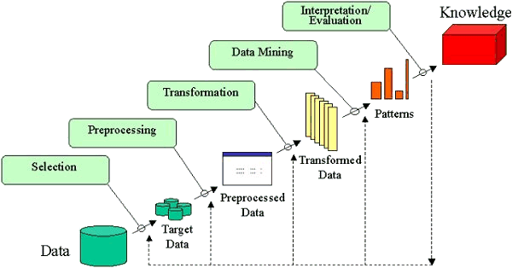
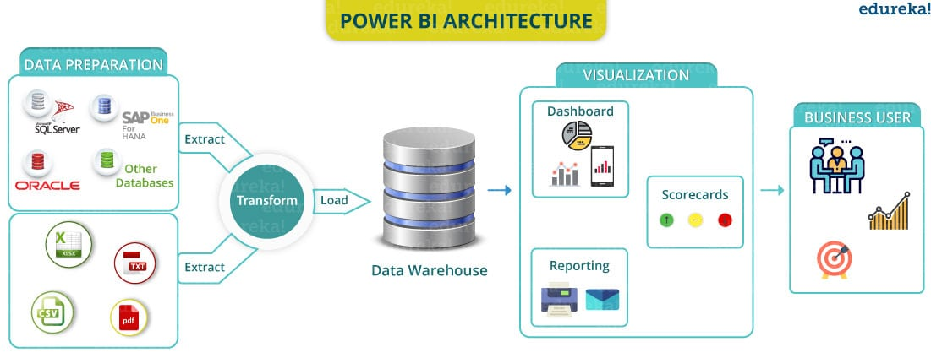
Methodology

Slide 6





Thank You
Thank you

